Slide 1

Investigating temperature variations of solar corona during Coronal Mass Ejections
Department of Physics and Electronics
Masters Thesis Presentation
By
V DHEERAJ SHENOY
USN: 22MSRPH022
Guide | Co-Guide
M N Sundar | Dr. Tanmoy Samanta
Jain University | Indian Institute of Astrophysics

Slide 2
Introduction
Solar Corona
Filaments/Prominences
Flares
Coronal Mass Ejections (CMEs)
Stellar CMEs
Coronal Dimming
Emission Measure & Differential Emission Measure

Slide 3
Objectives
Understand the temperature variation of solar corona during Coronal Mass Ejections (CME)
Which temperature plasma shows the most coronal dimming ?
Differential Emission Measure (DEM) analysis of point source converted Sun.

Slide 4
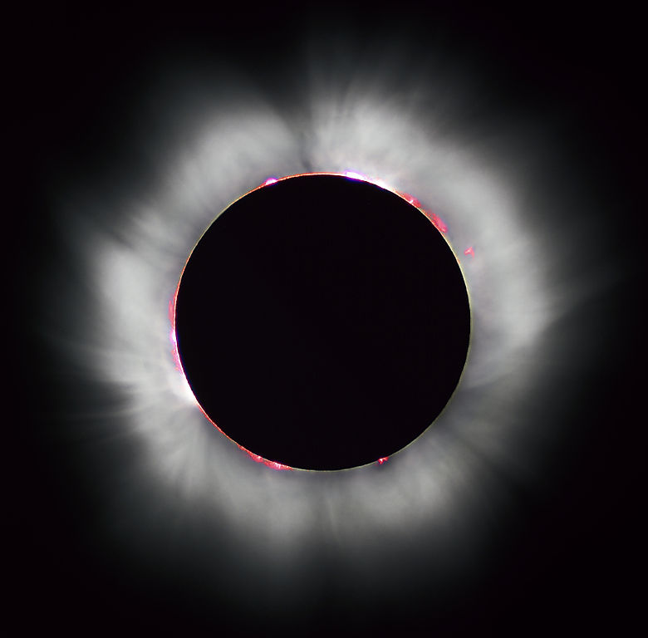
Solar Corona
Outermost part of atmosphere of Sun
Several million degree Kelvin
Contains forbidden Iron lines (Fe XIV)
Very low density compared to the lower layers
Solar corona seen during total solar eclipse (Image credit: NASA)

Slide 5
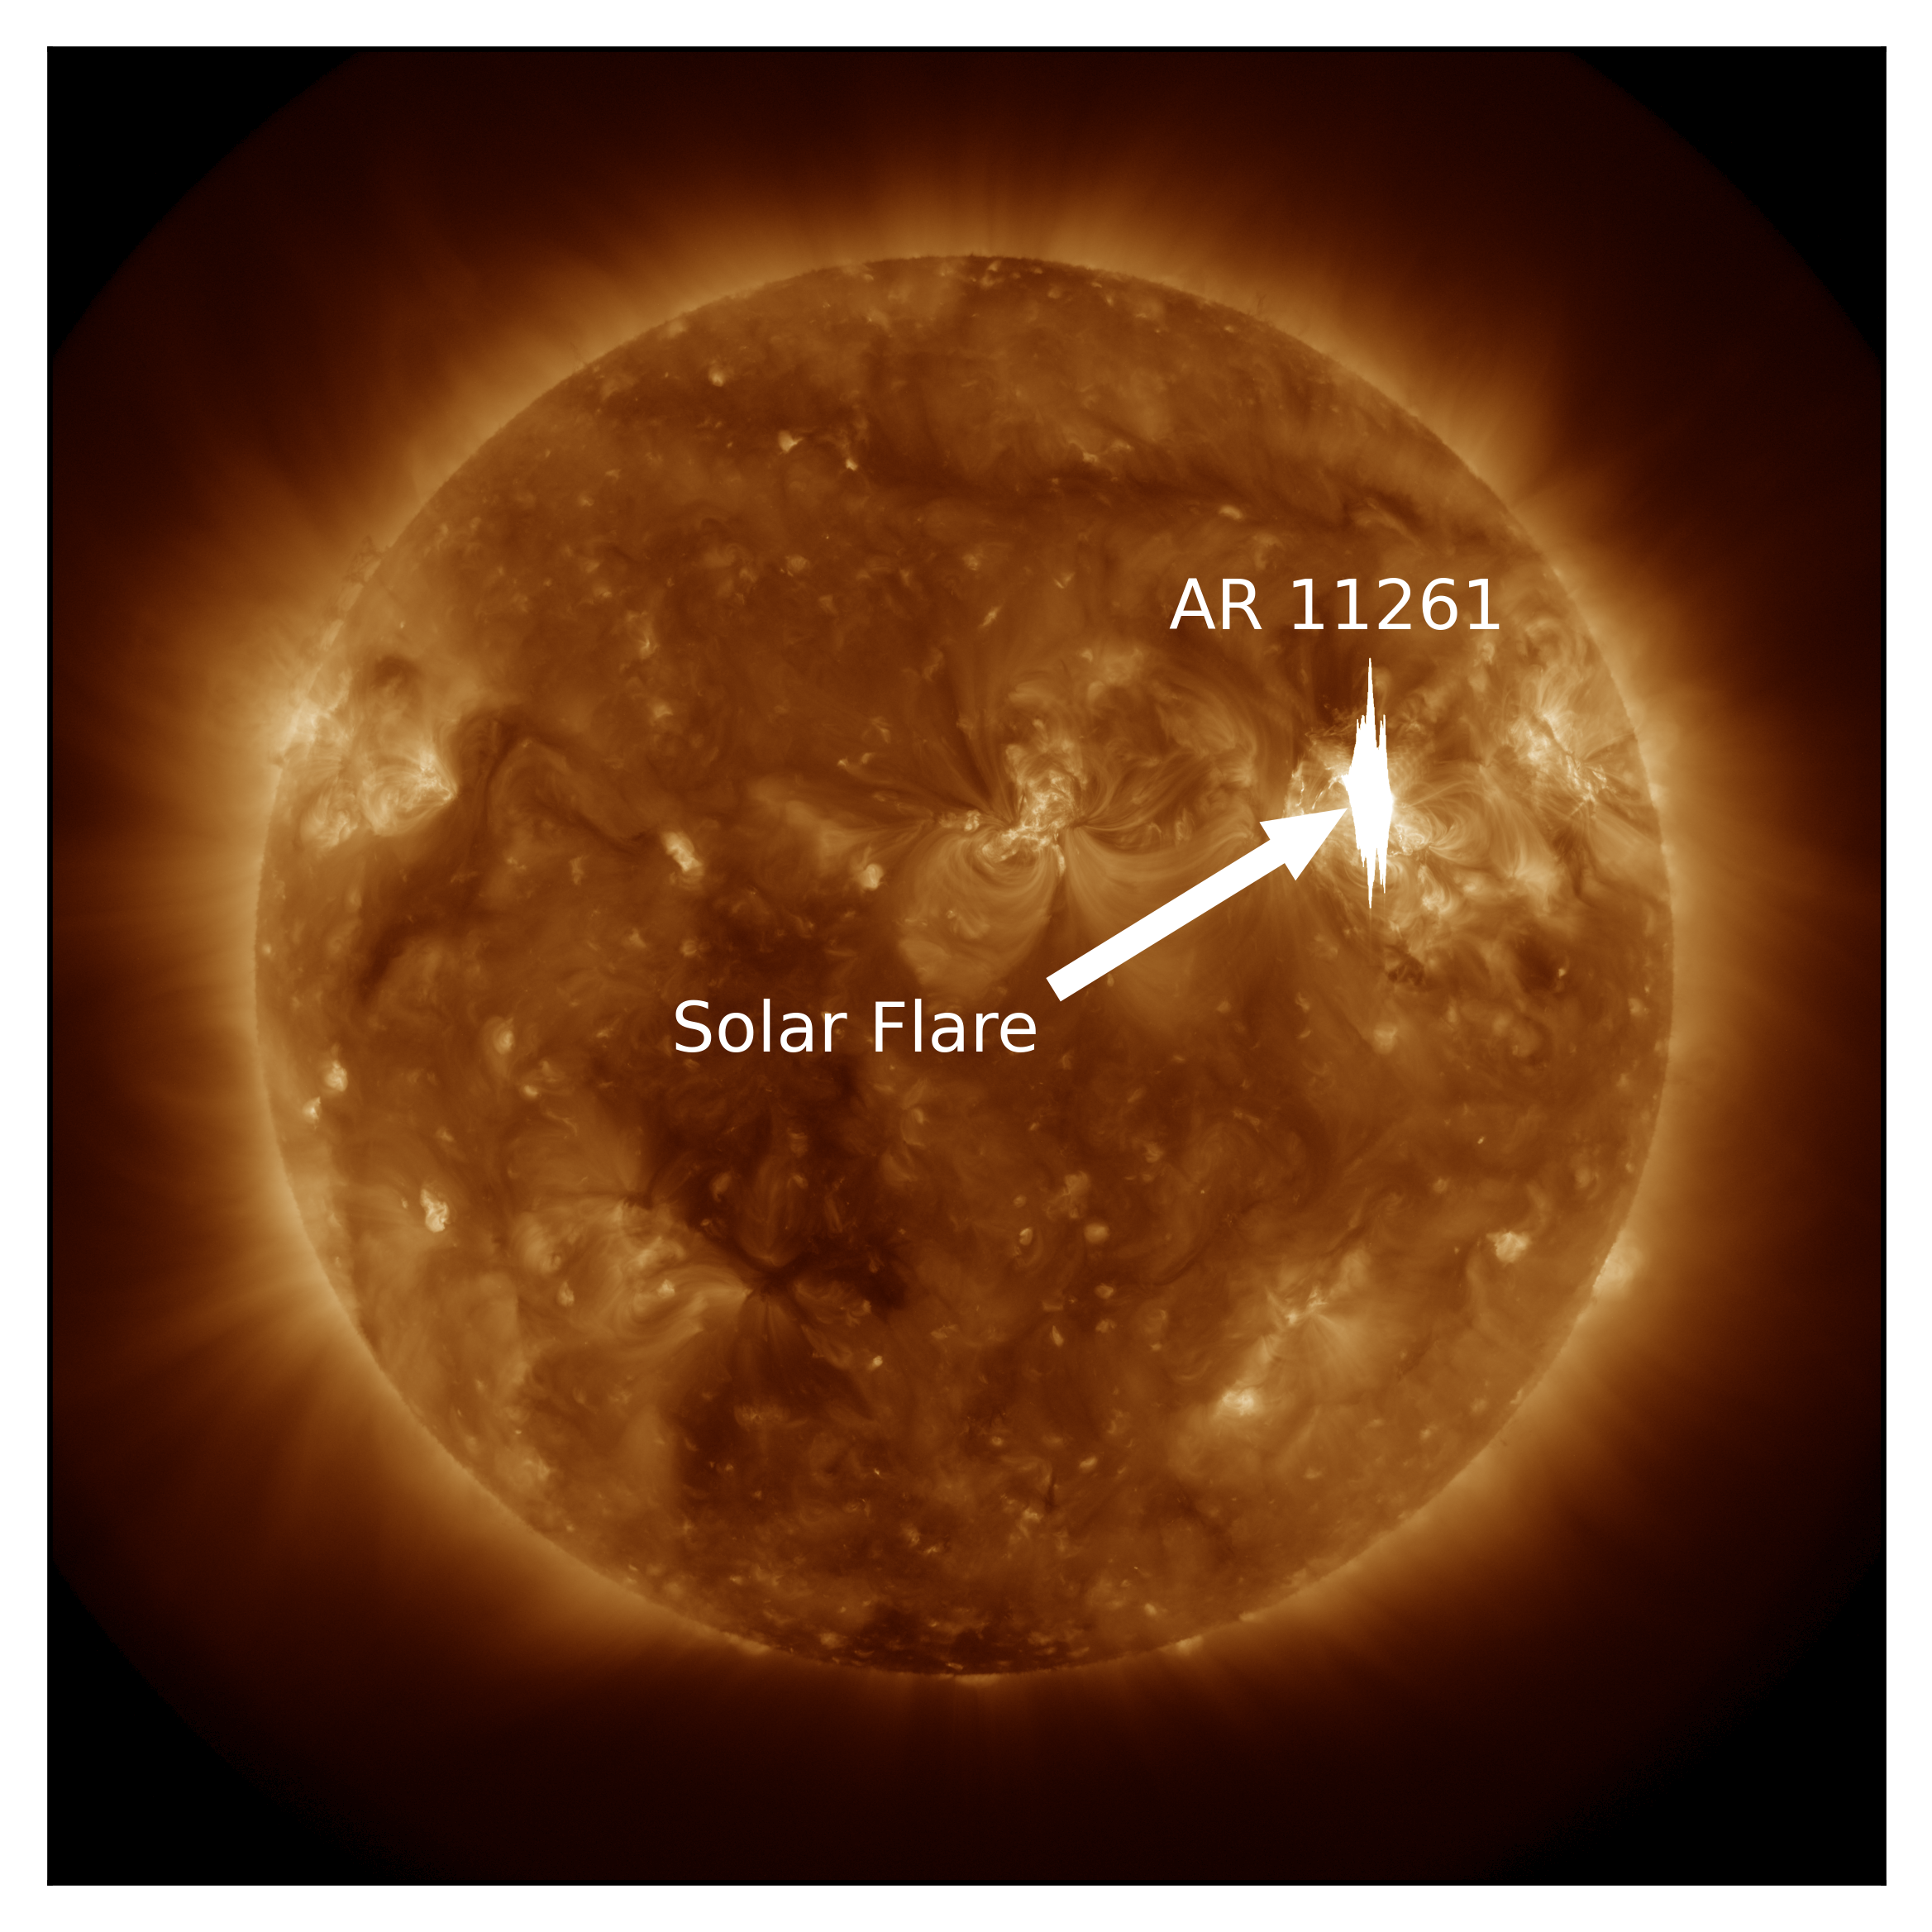
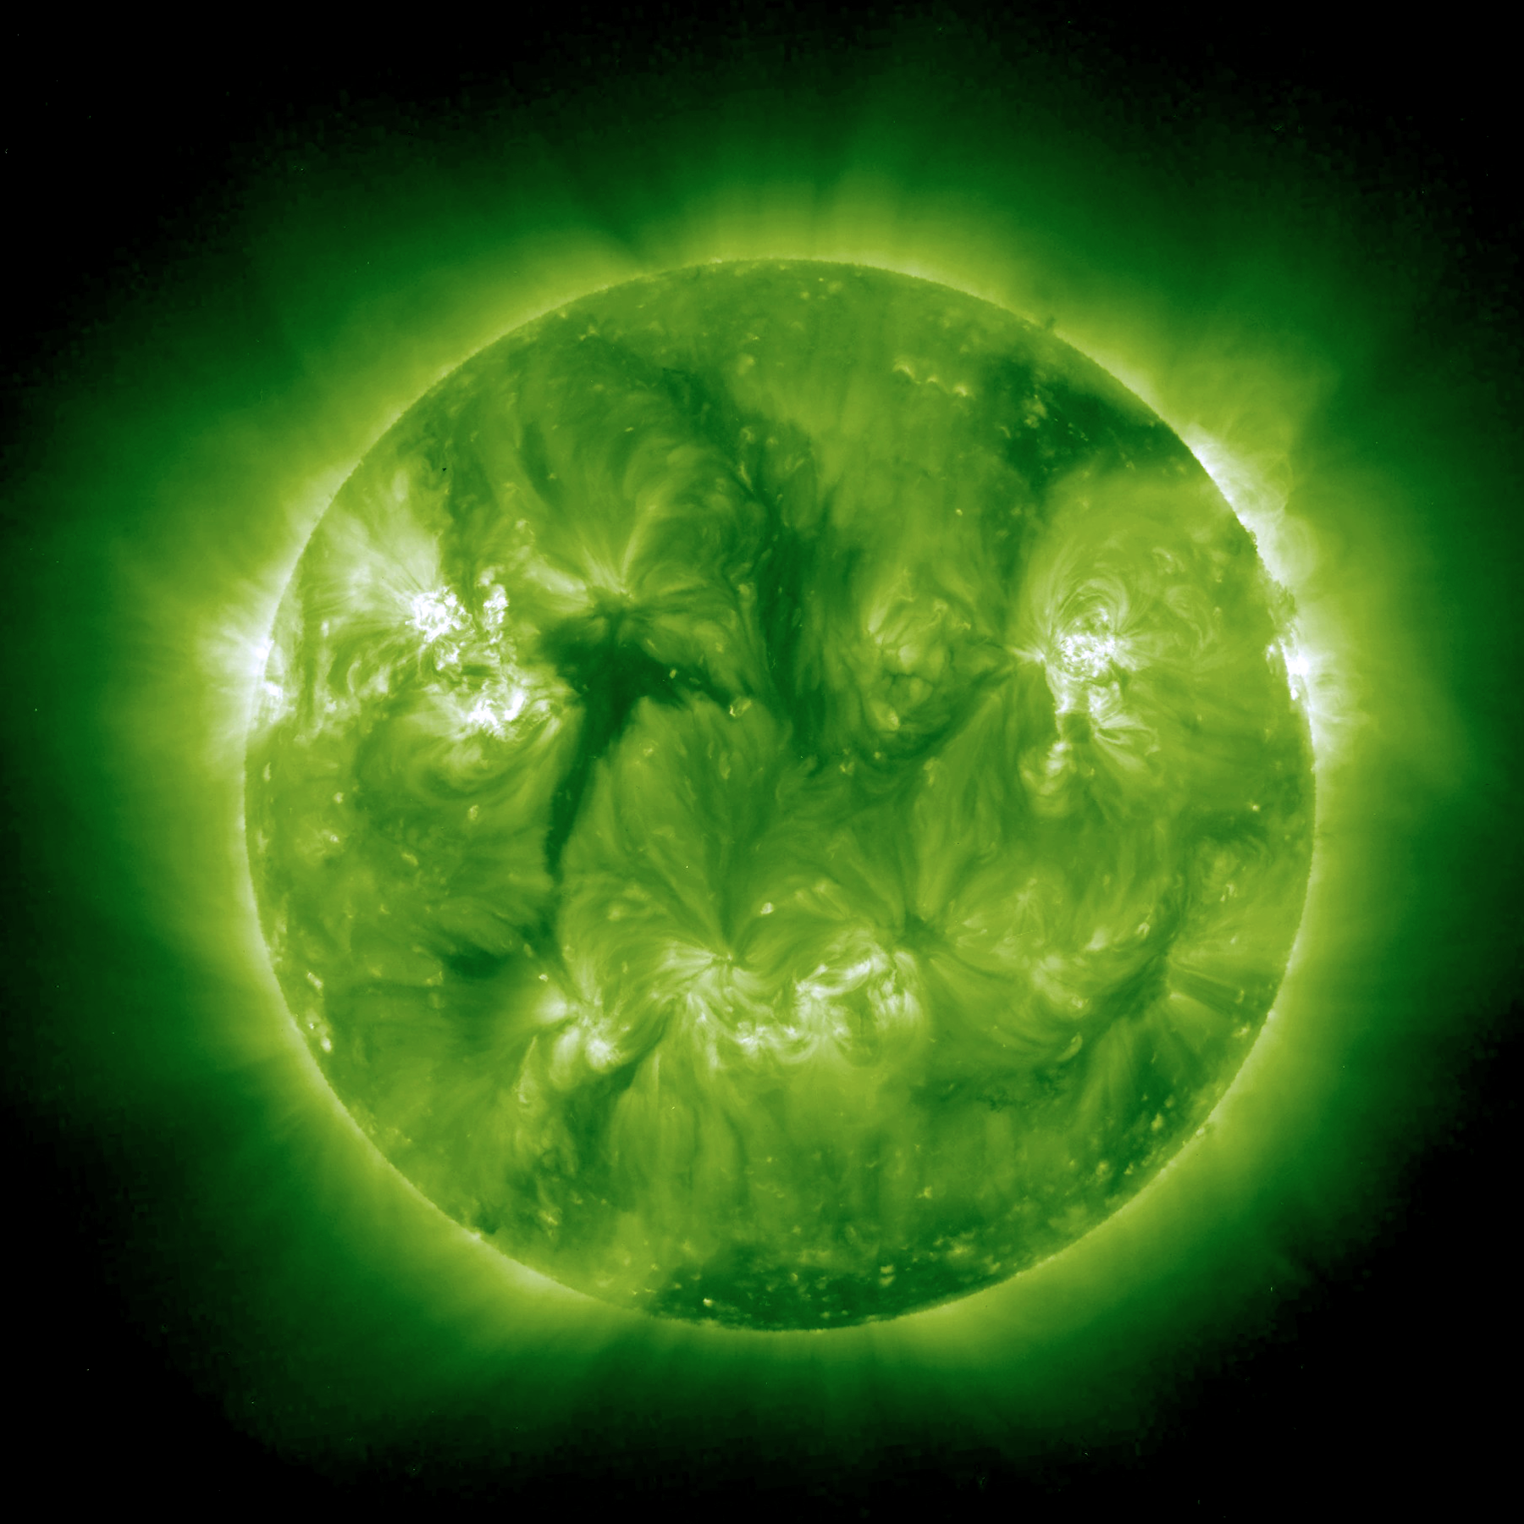
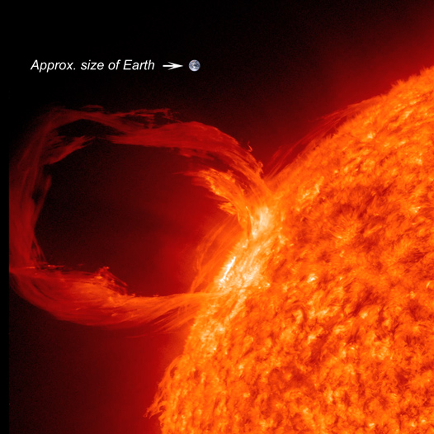
Solar flares
Explosive phenomenons due to magnetic reconnection
Accompanied by filament/prominence eruptions and CMEs
Flaring event of 2011 August 4th
Filament
Prominence (Image credit: NASA/SDO)

Slide 6
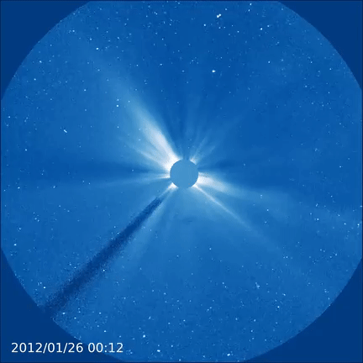
Coronal Mass Ejections
Plasma Ejections into Heliosphere
Often associated with flares
Very high association of phenomena of coronal dimming
Made up of charged particles
High magnetic field enclosure
Affects the space weather, satellite communications etc.
LASCO C3 image of a CME
(Image credit: SOHO/LASCO (ESA & NASA))
Temperature variation of the Solar Corona during Coronal Mass Ejections

Slide 7
Stellar CMEs
Like solar CMEs
Highly energetic
Difficult to observe
No spatial resolution
Indirect methods to detect stellar CMEs
Coronal Dimming
Blueshifted chromospheric lines
Type-II and Type-IV radio bursts etc.
Temperature variation of the Solar Corona during Coronal Mass Ejections

Slide 8
Literature Survey
EM distributions from SDO/AIA data alone can overestimate the amount of high temperature (logT > 6.4) plasma in the solar corona by a factor of 3-15 (Athiray and Winebarger, 2024)
About 73 % association of CME events with eruptive filaments has been observed (Sinha et al., 2019)
Information about the underlying CMEs like mass and velocity of the CMEs ejected by knowing the depth and slope of the dimming curve (Mason et al., 2016)
The association of dimming with a CMEs and assocation of CME with dimming has been observed to be very high (Veronig et al. 2021)
Kinetic energy of stellar CME to the stellar flaring energy not being anywhere close to being a scaled version of the solar case (Namekata et al., 2022).
Redshifted components of stellar filament eruptions in Sun-as-a-star analysis in Hα spectra may develop into CMEs (Otsu et al.,2022)
Temperature variation of the Solar Corona during Coronal Mass Ejections

Slide 9
Methodology
Downloading level 1 Images of Sun
DEM is obtained for the full disk image of Sun.
Convertion of full disk to point source: full disk data is converted to a point source (pointification).
Calculating DEM for the point source
Compare the DEM curves of full disk and point source.
If CME is associated with dimming, find the maximum dimming temperature region.
Study the DEM profile which gives information about the coronal temperature variation
Temperature variation of the Solar Corona during Coronal Mass Ejections

Slide 10
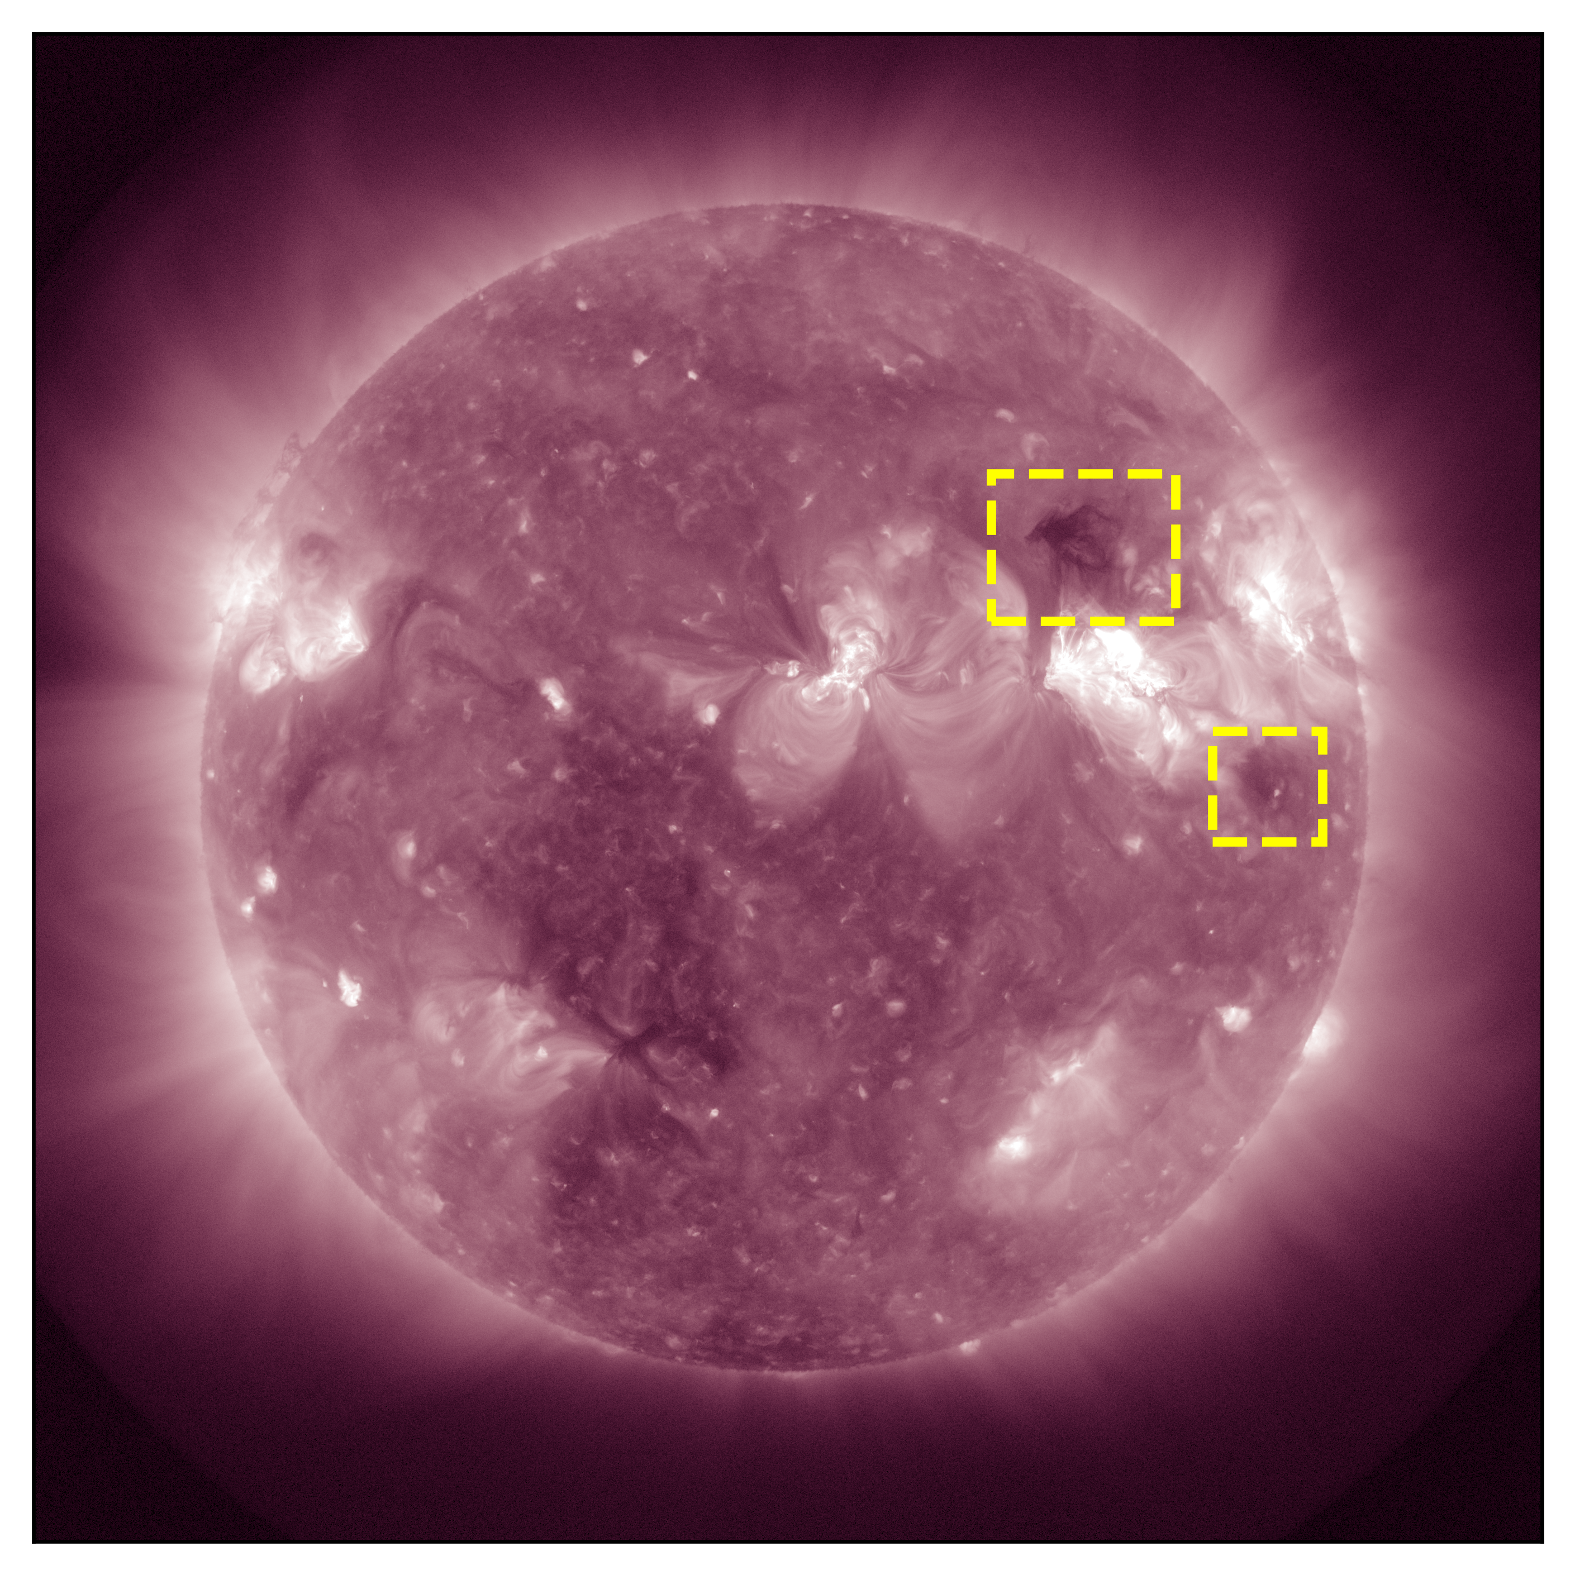
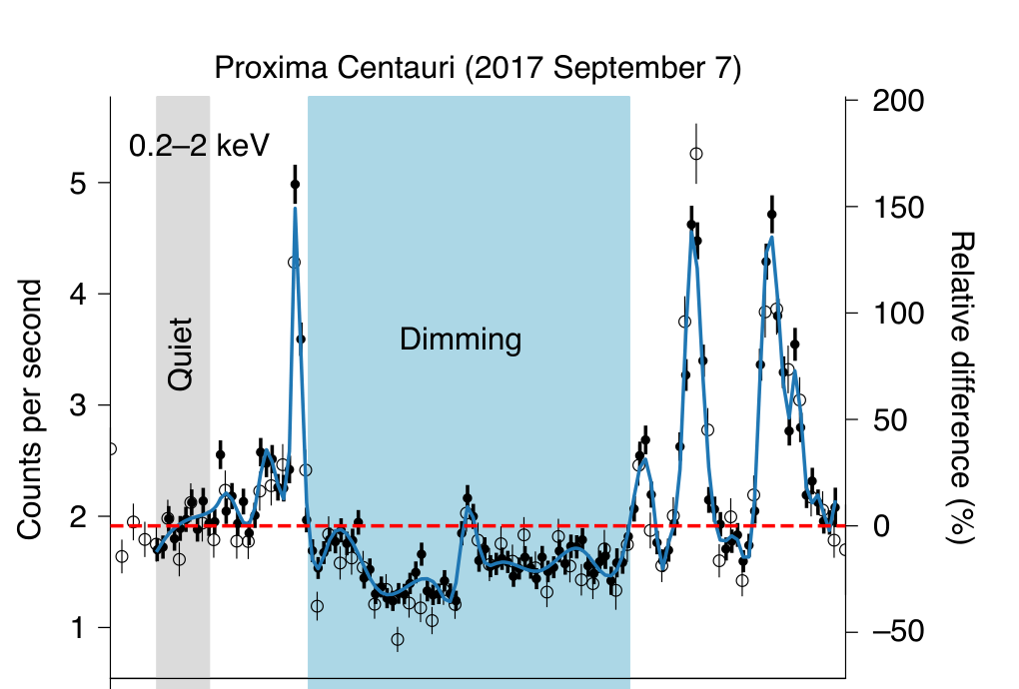
Coronal Dimming
Dimming seen on a star. Image Credit: (Veronig et al.)
211 Å channel of AIA. Yellow boxes shows the dimming
Temperature variation of the Solar Corona during Coronal Mass Ejections

Slide 11
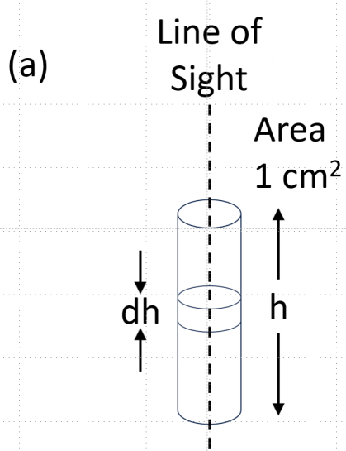
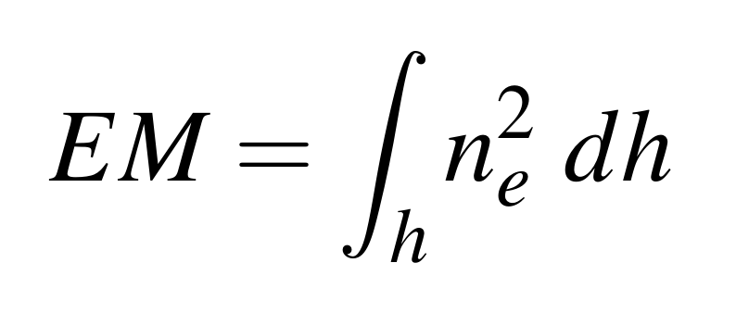
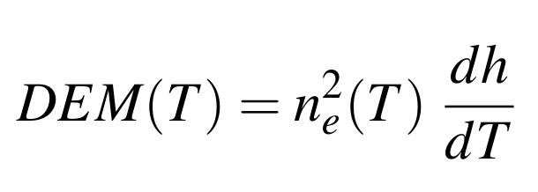
Differential Emission Measure (DEM)
DEM – emission measure with respect to temperature. Function of temperature.
Where ne is the electron number density
Column emission measure
Temperature variation of the Solar Corona during Coronal Mass Ejections

Slide 12
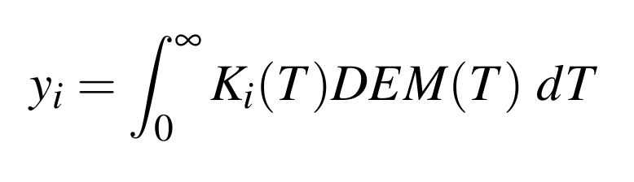
DEM Inversion
Obtain the information about the plasma from the line intensities observed
We can only approximate the underlying EM profile.
We use Reiterative Maximum Likelihood (RML) method (Massa et al., 2023)
Ki is the temperature response of each channel
Temperature variation of the Solar Corona during Coronal Mass Ejections

Slide 13
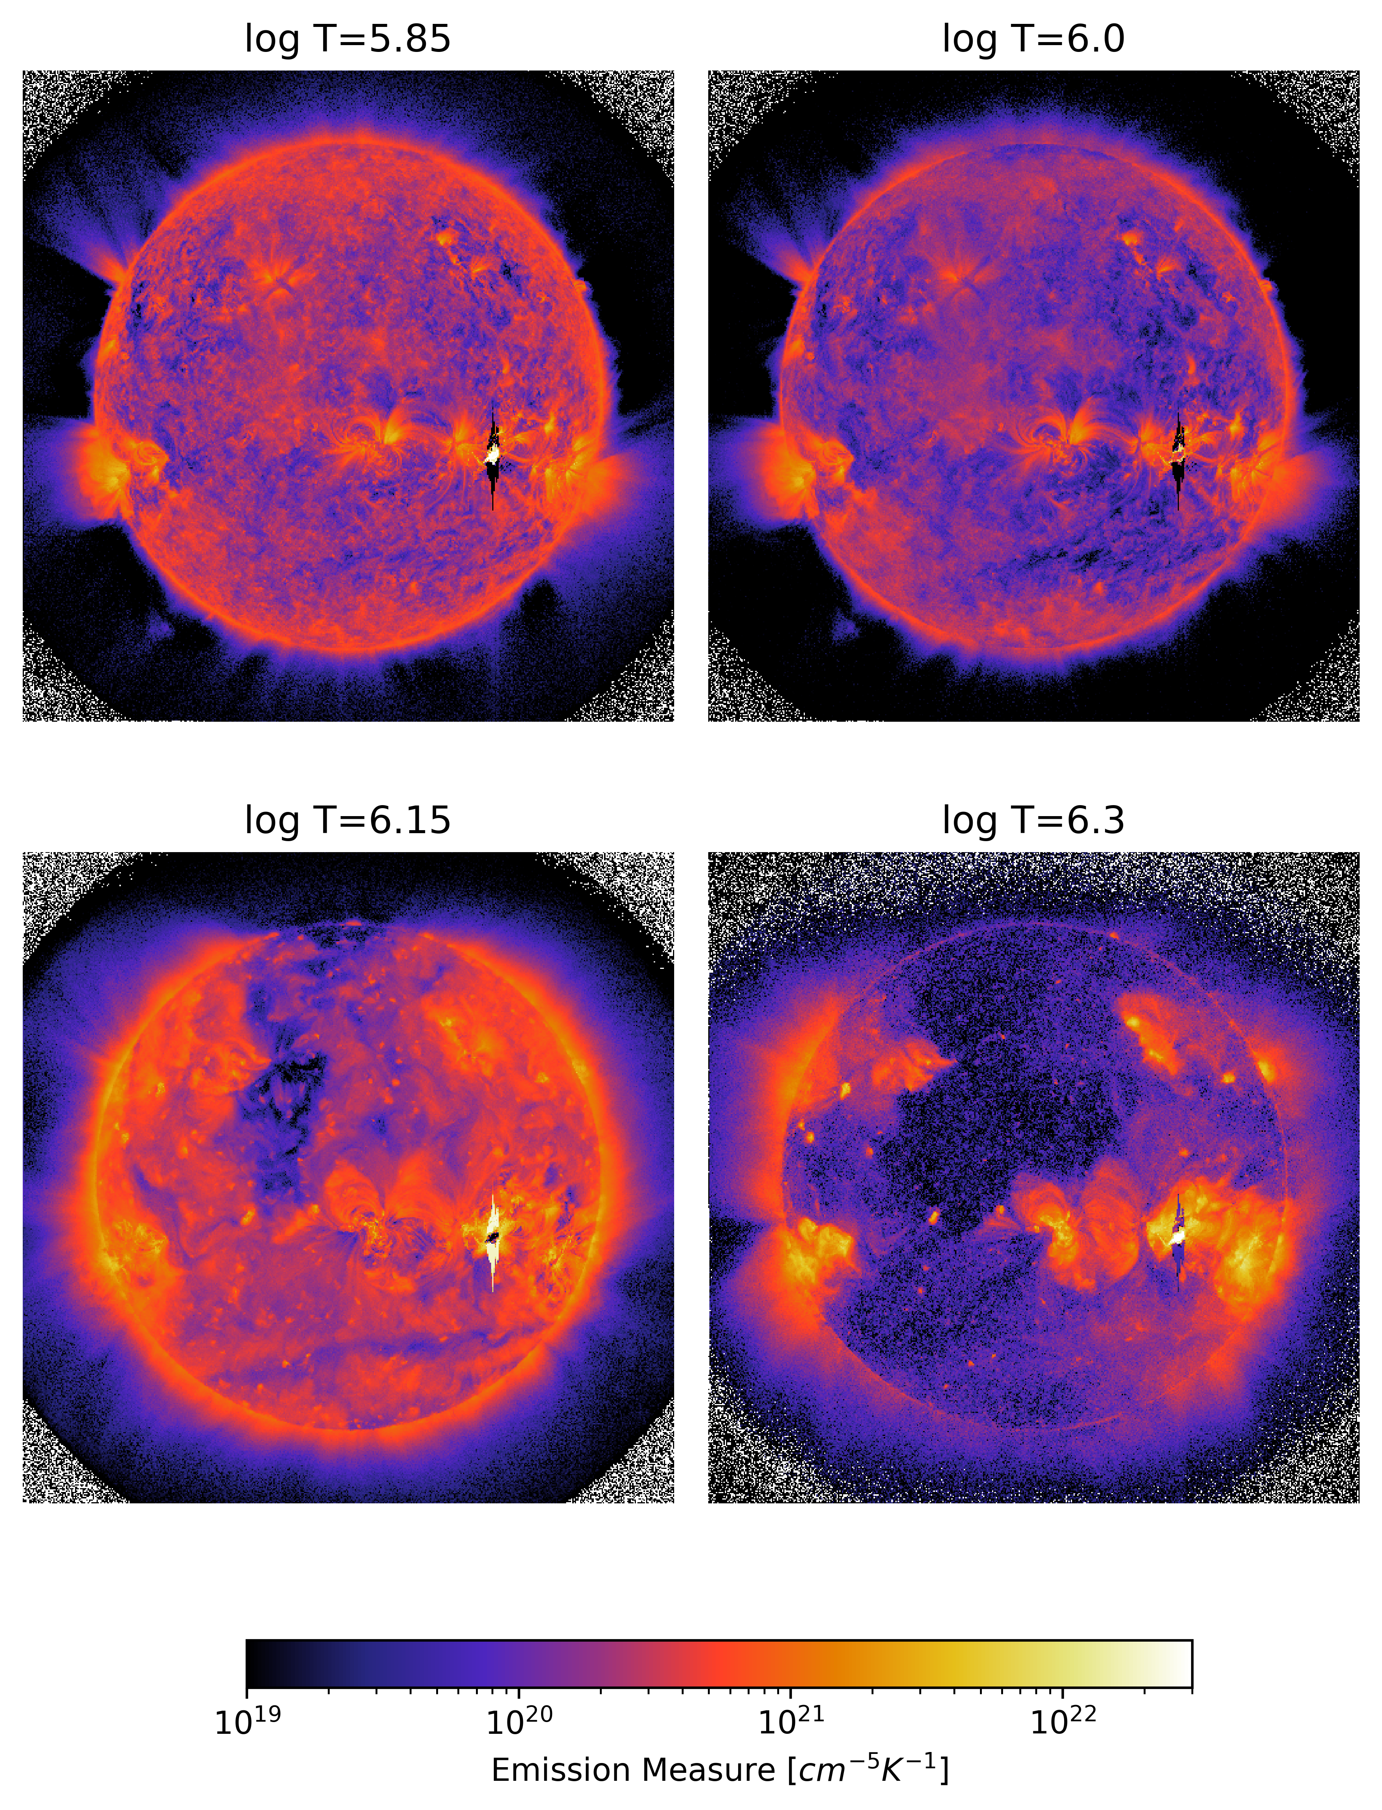
DEM of Sun during the flaring event of August 4th 2011
Temperature variation of the Solar Corona during Coronal Mass Ejections

Slide 14
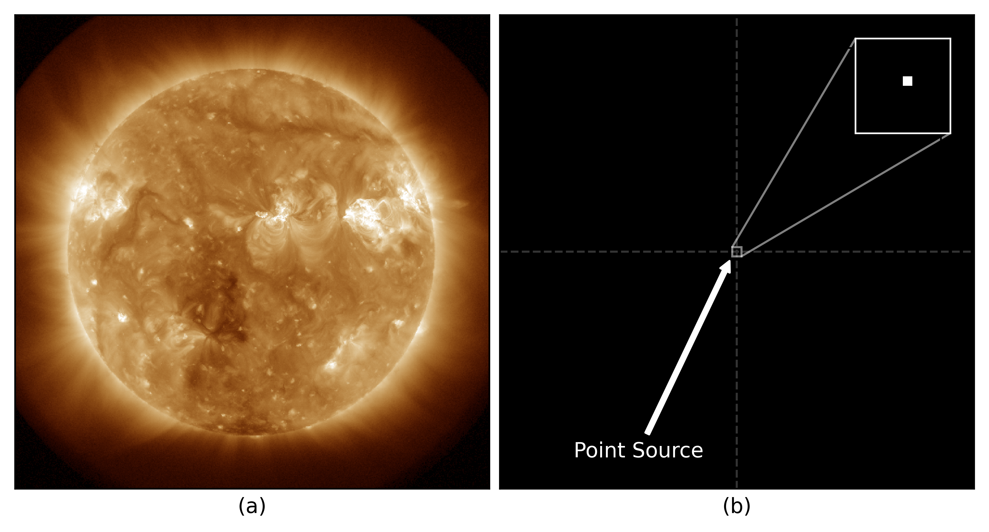
“Pointification” of sun full disk image
a) shows the full disk image of Sun. (b) Image after pointification
Temperature variation of the Solar Corona during Coronal Mass Ejections

Slide 15
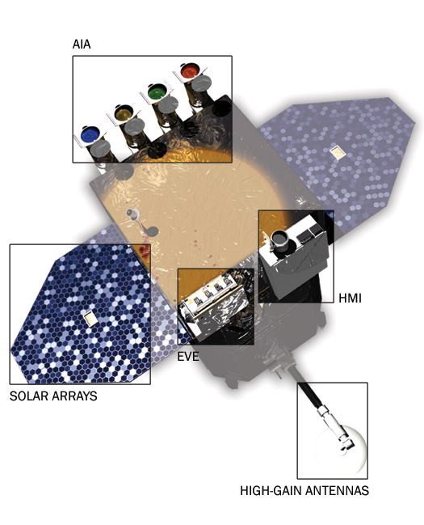
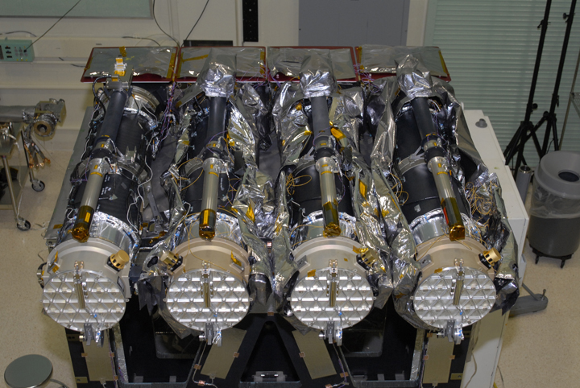
Data
NASA’s Solar Dynamics Observatory - Atmospheric Imaging Assembly (SDO/AIA)
Three CME event data
Flare associated CME (August 4th 2011)
Long filament eruption associated with a CME (August 31st 2012)
Ground Level Enhancement CME (21st October 2021)
NASA’s SDO Space Observatory
(Image Credit: NASA/SDO)
Four telescopes of SDO/AIA (Image Credit: NASA/SDO)
Temperature variation of the Solar Corona during Coronal Mass Ejections

Slide 16
Results
Temperature variation of the Solar Corona during Coronal Mass Ejections

Slide 17
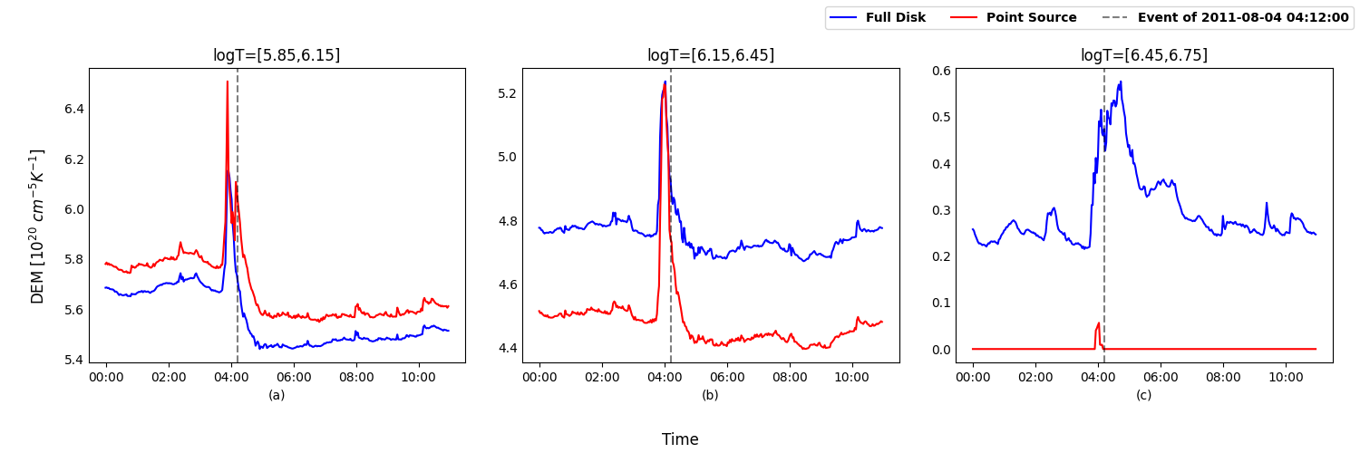
Coronal Dimming
DEM Timeseries of August 4th 2011 CME event
Temperature variation of the Solar Corona during Coronal Mass Ejections

Slide 18
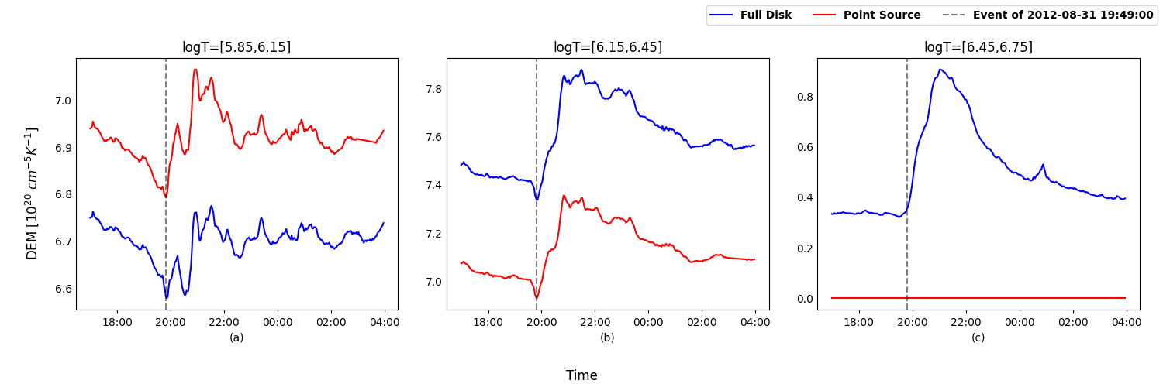
Filament Eruption
DEM Timeseries of August 31th 2012 CME event
Temperature variation of the Solar Corona during Coronal Mass Ejections

Slide 19
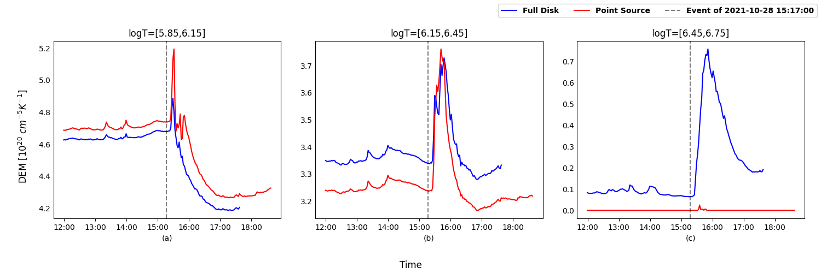
GLE CME event
DEM Timeseries of August 31th 2012 CME event
Temperature variation of the Solar Corona during Coronal Mass Ejections

Slide 20
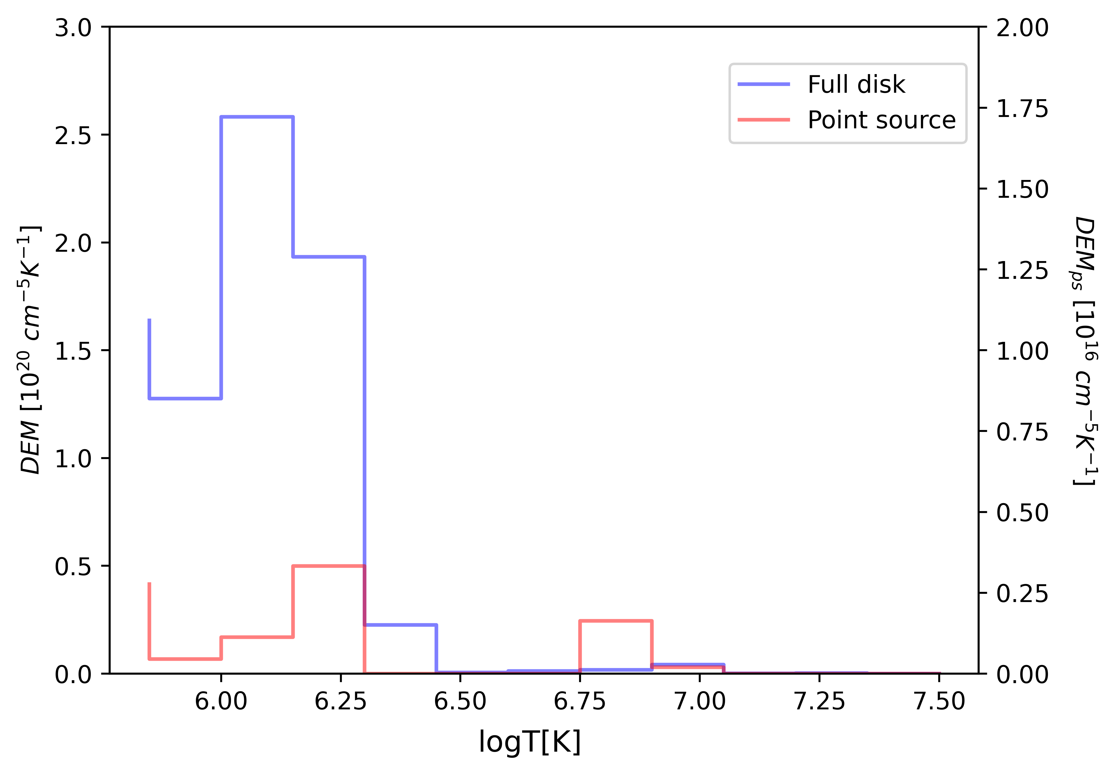
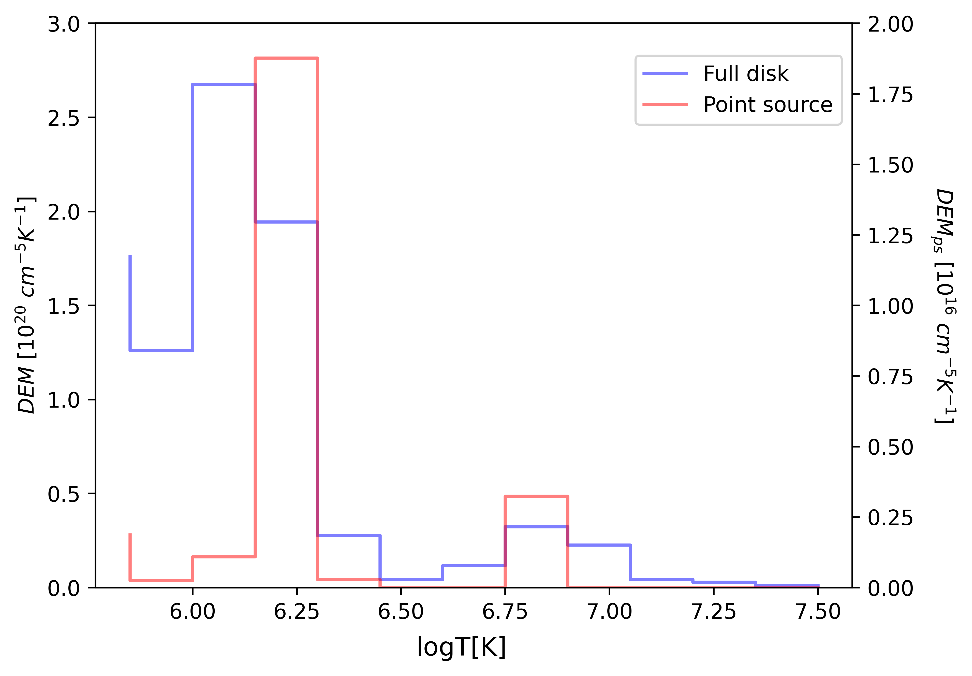
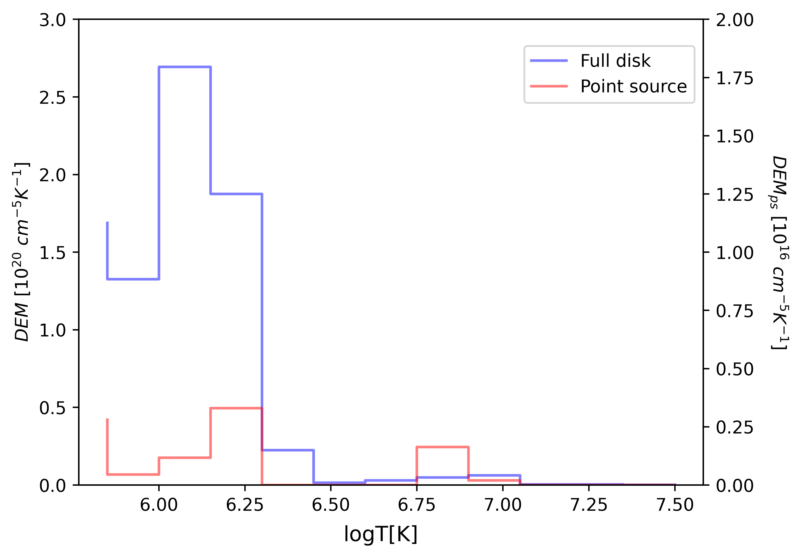
DEM profiles of 4th August 2011 Event
Before event
During event
After event
Temperature variation of the Solar Corona during Coronal Mass Ejections

Slide 21
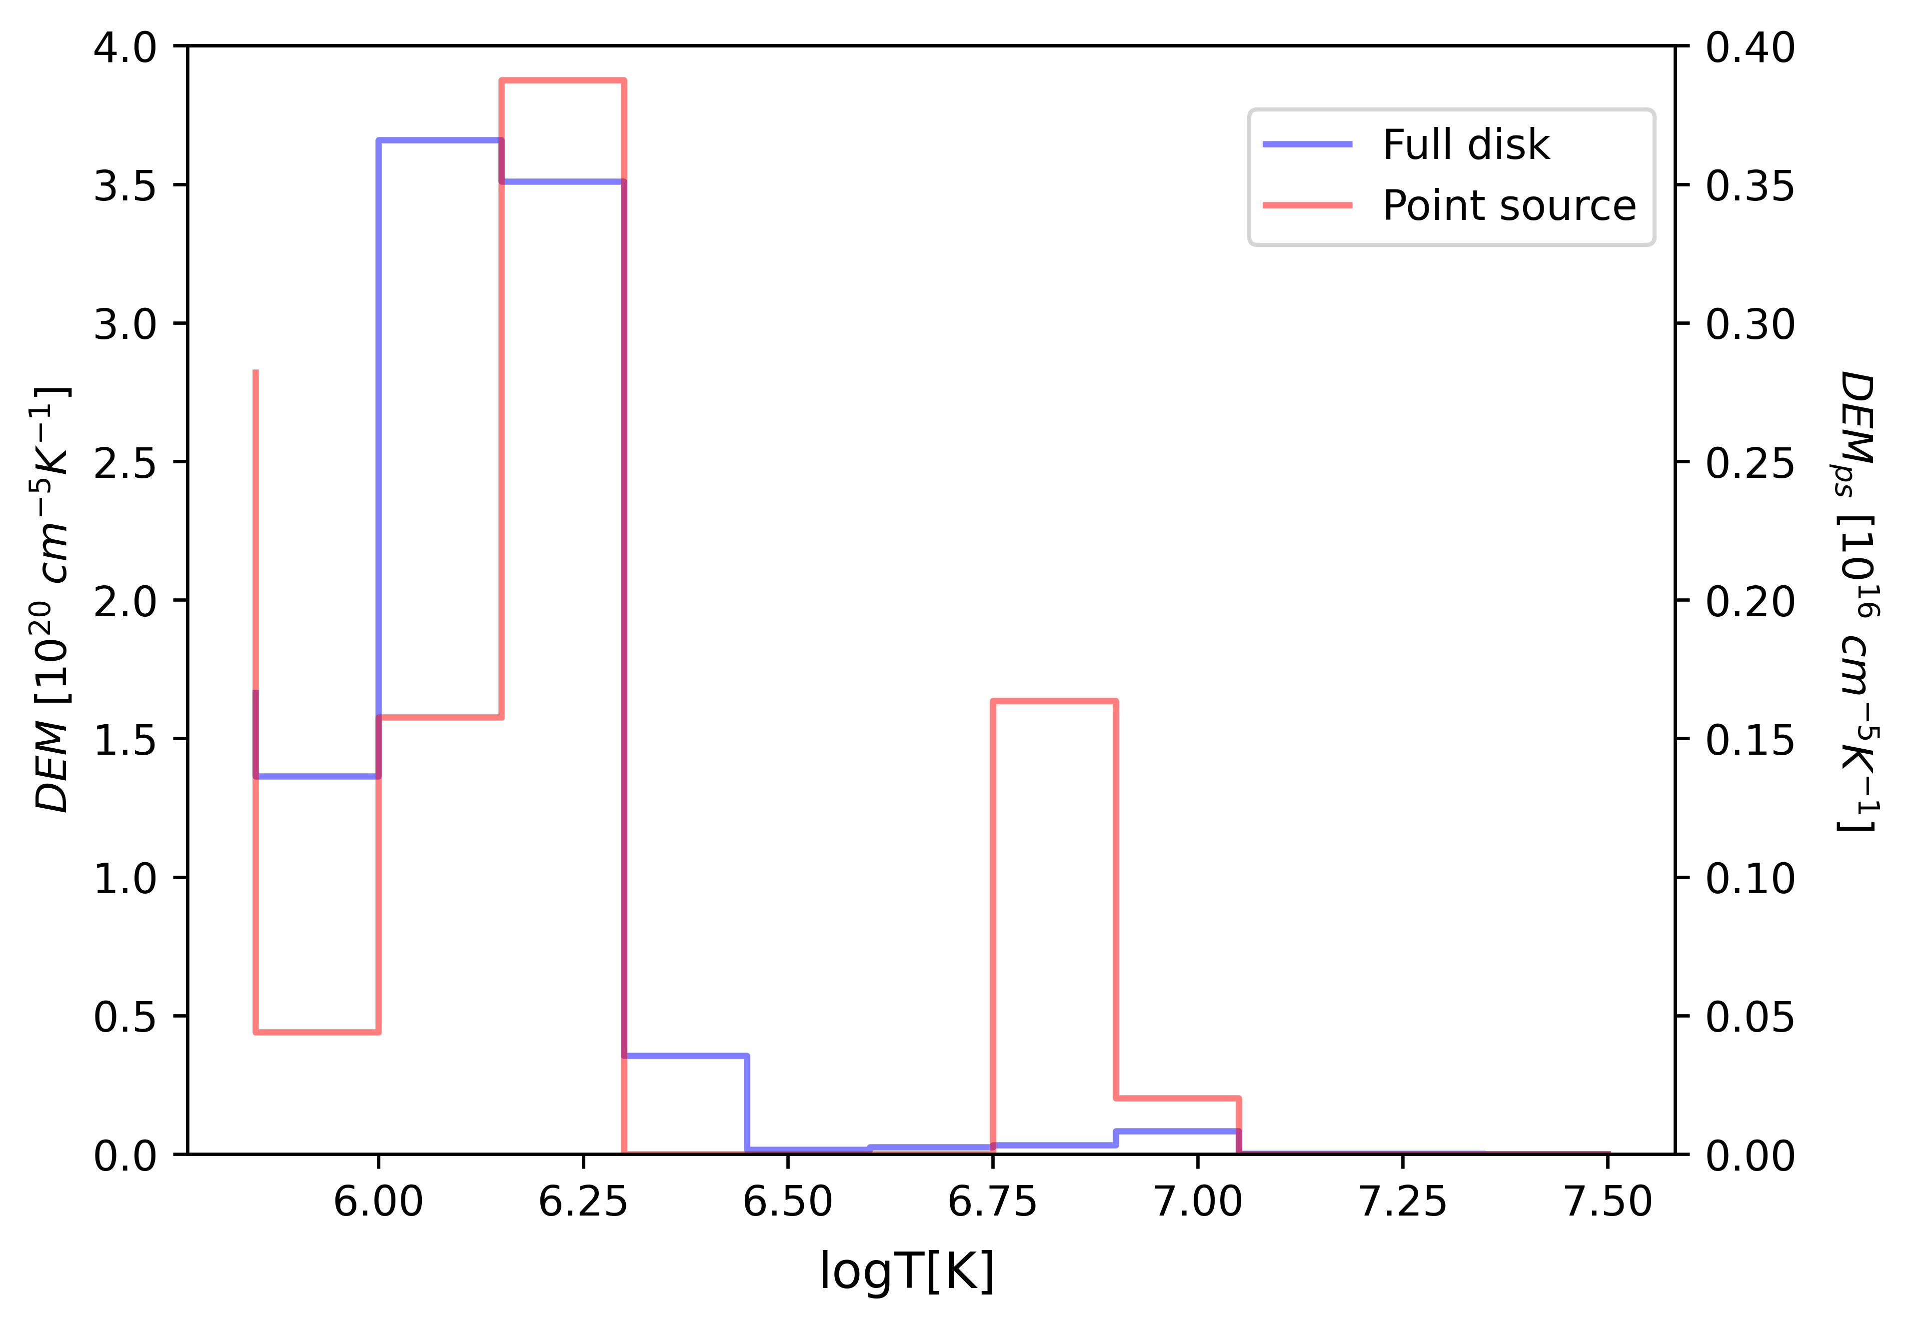
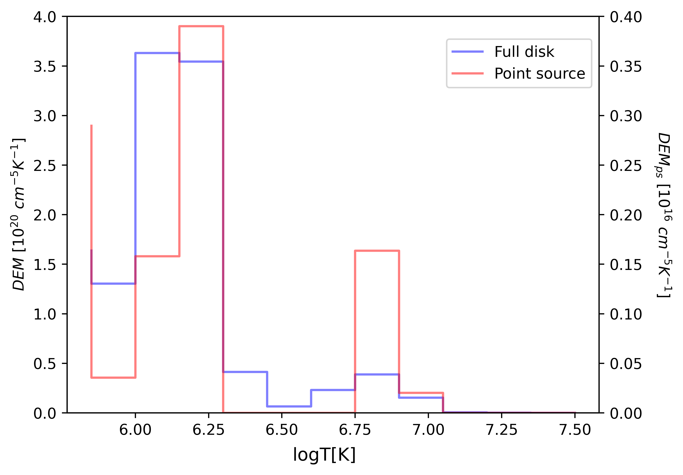
DEM profiles of 31st August 2012 Event
Before event
During event
After event
Temperature variation of the Solar Corona during Coronal Mass Ejections

Slide 22
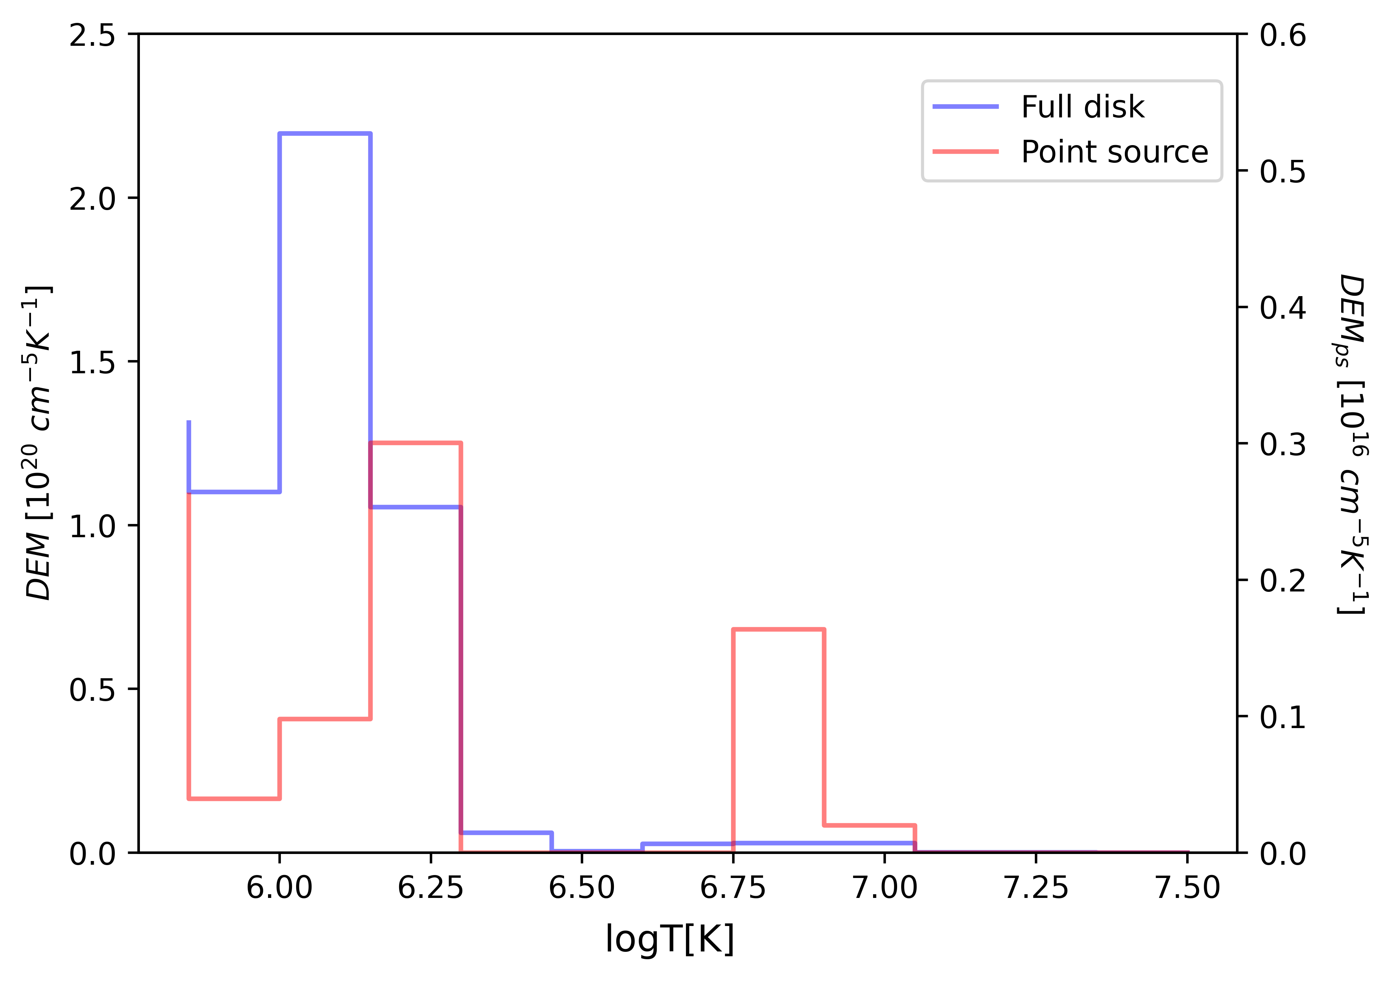
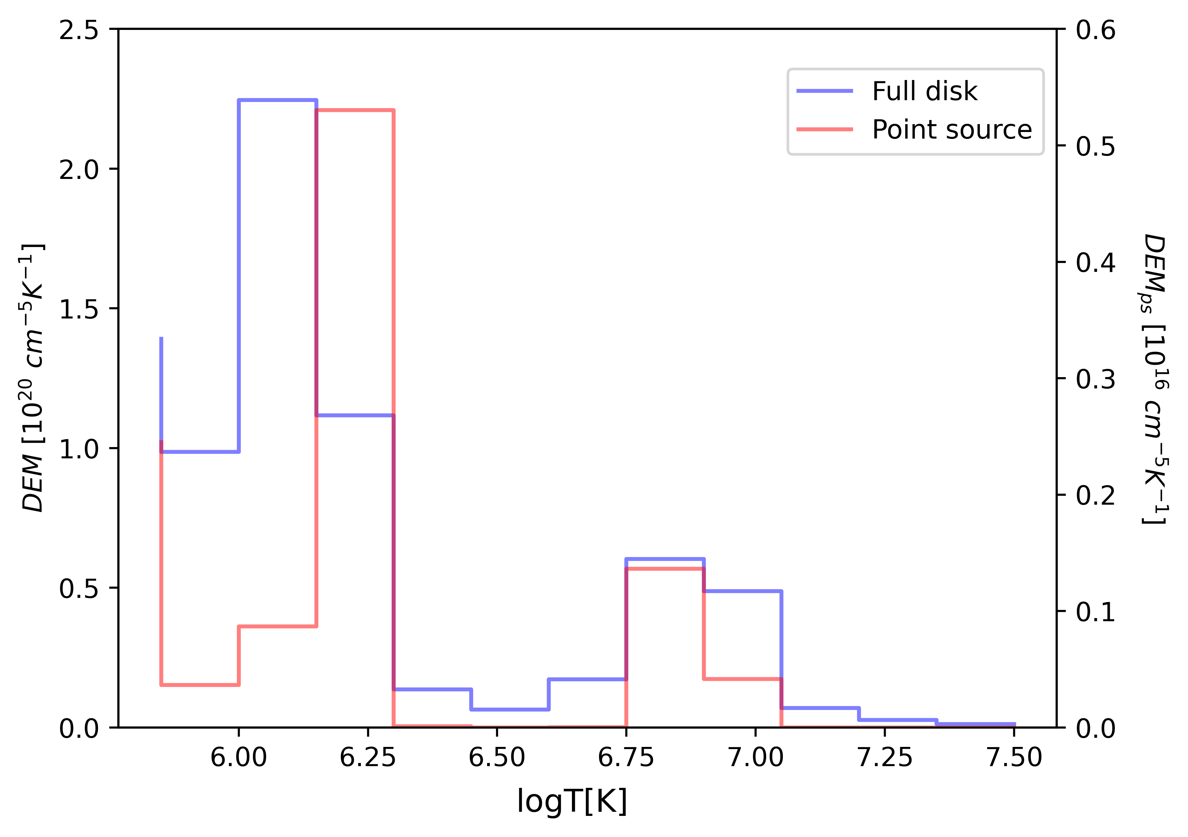

DEM profiles of 28th October 2021 Event
Before event
During event
After event
Temperature variation of the Solar Corona during Coronal Mass Ejections

Slide 23
Conclusion
Coronal dimming for 4th August 2011 event is most prominent in logT = [5.85, 6.15] range. Mass loss is more in this temperature
Good correlation between point source and full disk DEM solutions (below logT = 6.45).
Characteristic features of the CMEs on the full disk is still visible in the point source
Variations in coronal plasma temperature has been observed in both point source and full disk image before, during and after the event
Temperature variation of the Solar Corona during Coronal Mass Ejections

Slide 24
Moving forward
Correcting the pointification process by not direct averaging.
Look at events originating from various regions on the Sun
Statistical analysis to check the correctness of the correlation
Temperature variation of the Solar Corona during Coronal Mass Ejections

Slide 25
Acknowledgements
M. N. Sundar, Jain University
Dr. Tanmoy Samanta, Indian Institute of Astrophysics
Dr. Dhanush Shenoy for his constant support

Slide 26
Publications and Conferences
Manuscript of this work is under preparation to be submitted to the journal (The Astrophysical Journal).
The two-days Scientific Extravaganza ‘MilICon–2023’ is an Internation Conclave on Millets, held at Jain (Deemed-to-be University), School of Sciences. Best paper and presentation award for the paper titled “Could AI/ML help yield loss in Millets?”.
Paper titled “Crop Health Managemenet in Millets using Satellite Imagery and Neural Networks” has been submitted to VEGETOS: An International Journal of Plant Research & Biotechnology, The paper is currently under review for publication.
National Space Science Symposium - 2024 Conference , Goa University: Poster presentation for the paper titled “Crop Health Management in Millets using Satellite Imagery and Neural Networks”

Slide 27
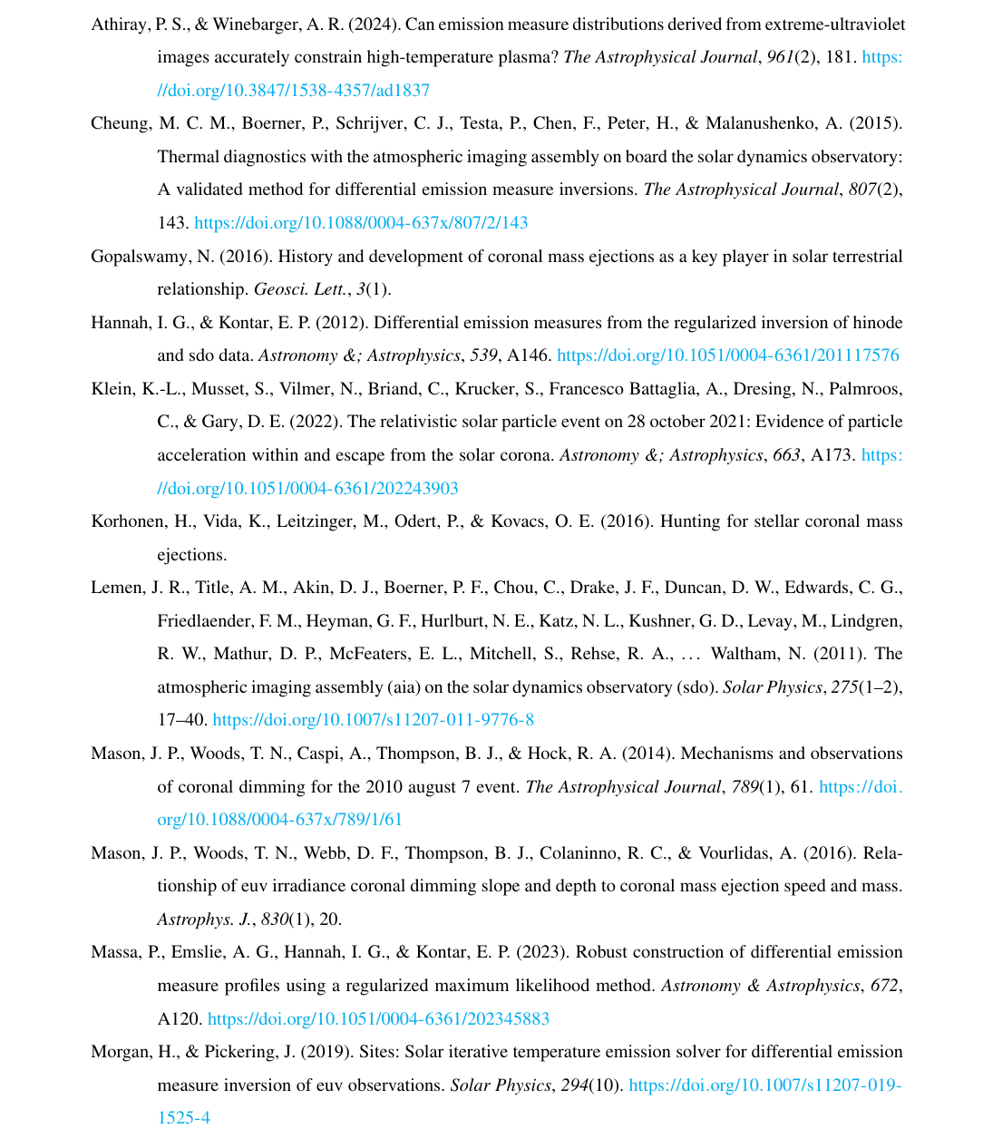
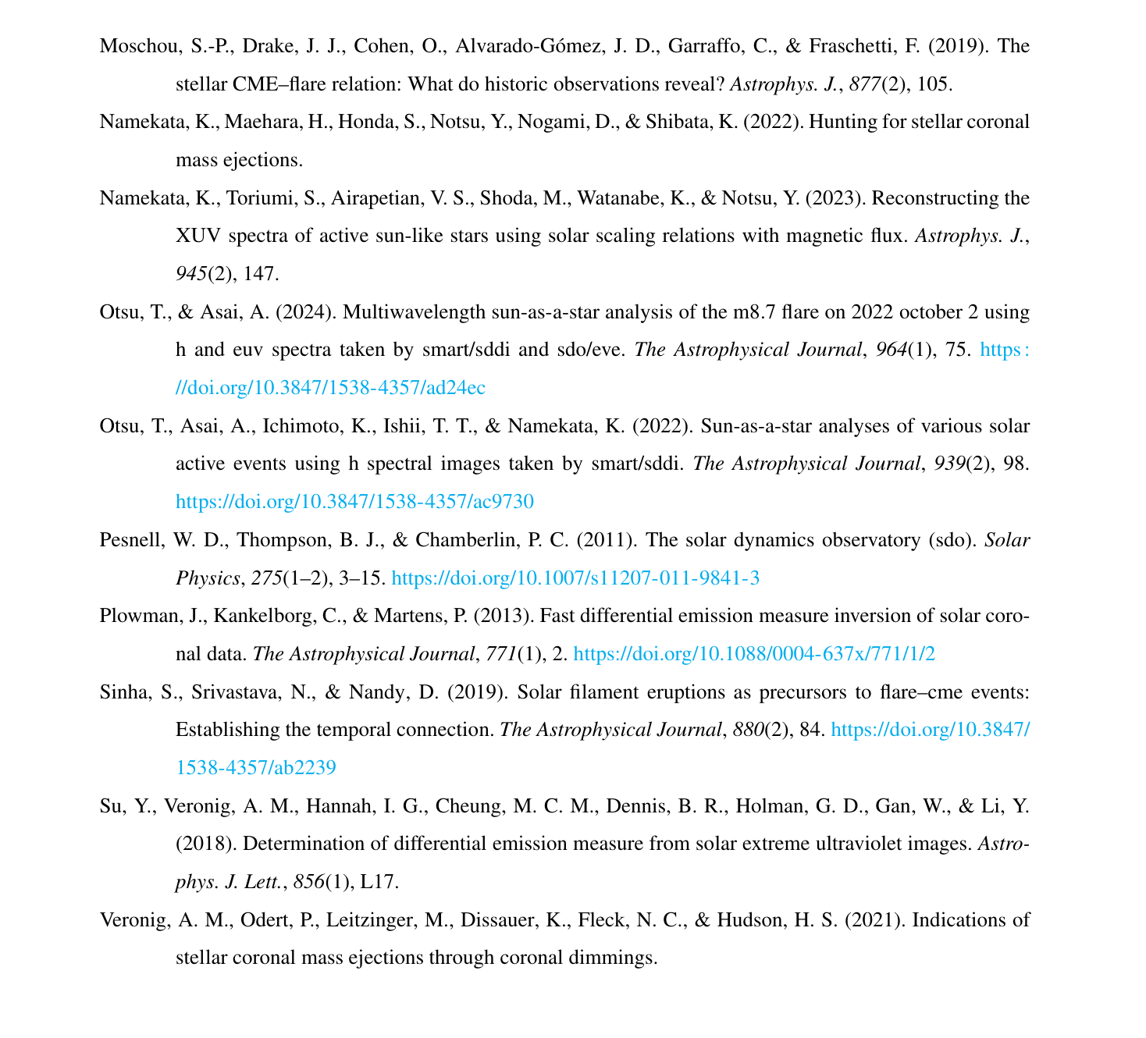
References

Slide 28
Thank you
Temperature variation of the Solar Corona during Coronal Mass Ejections

Slide 29
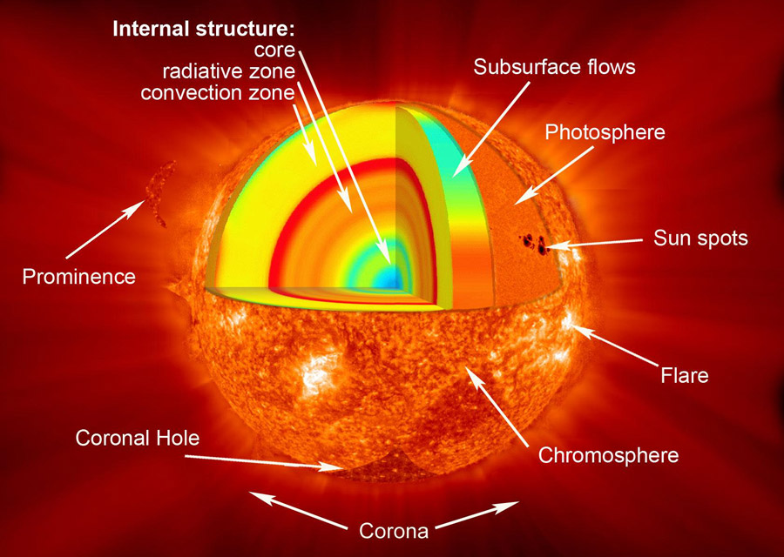
Solar structure
Interior region
Core
Radiative zone
Convective zone
Visible surface
Photosphere
Atmosphere
Chromosphere + Corona
Structure of Sun (Image credit: NASA)

Slide 30
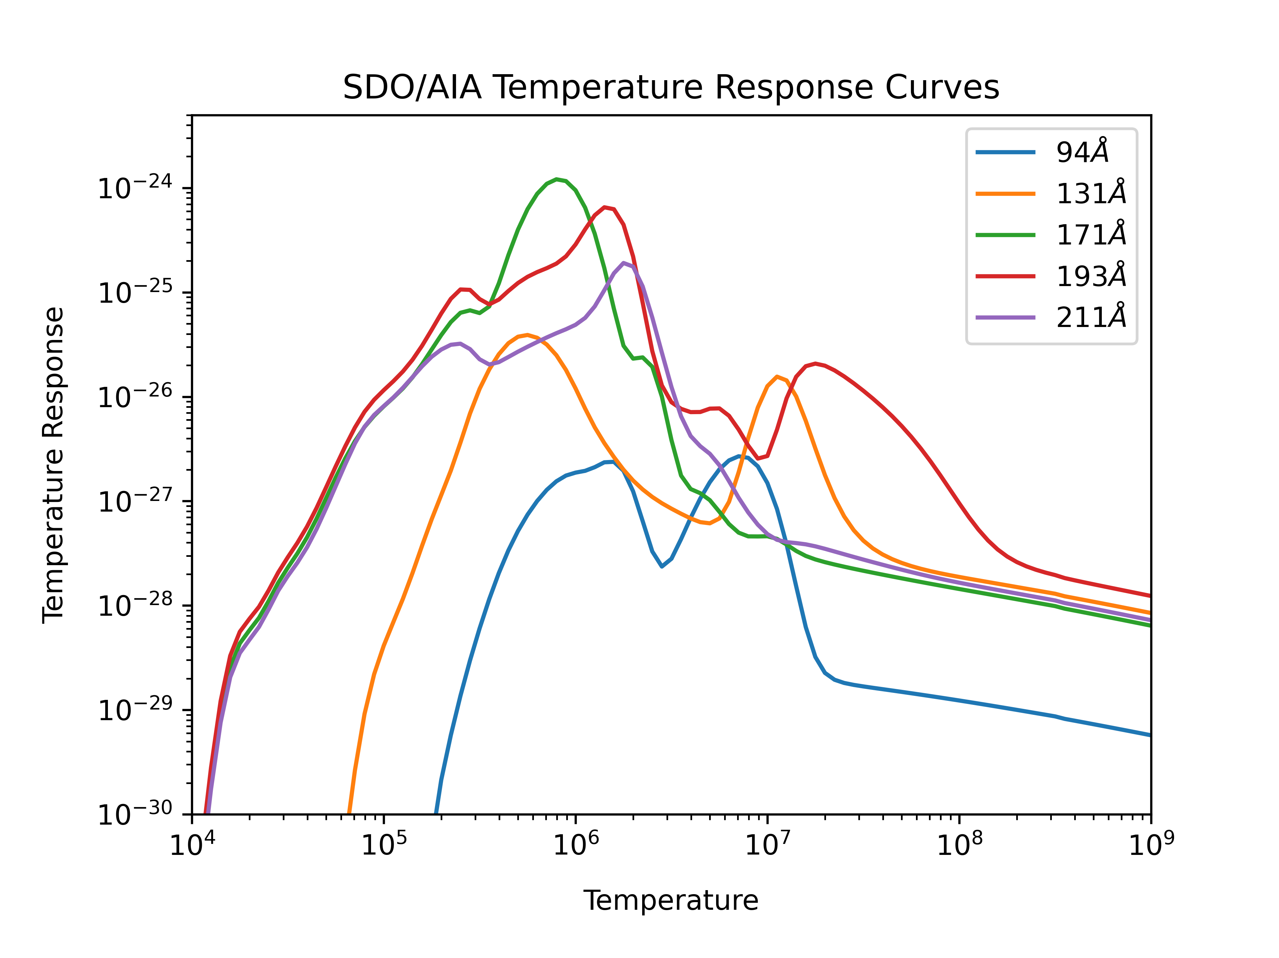

Slide 31
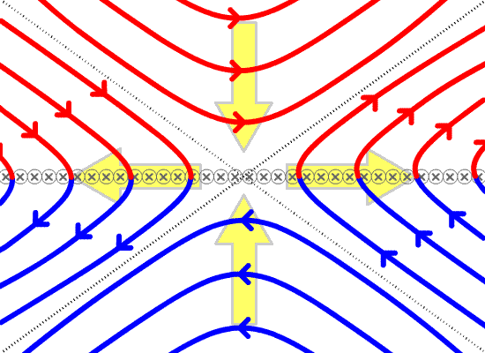
Magnetic Reconnection
Image credit: Wikipedia

Slide 32
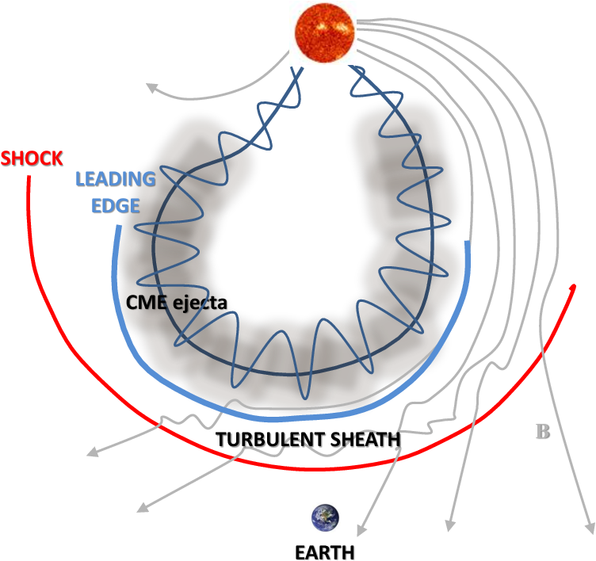

Slide 33
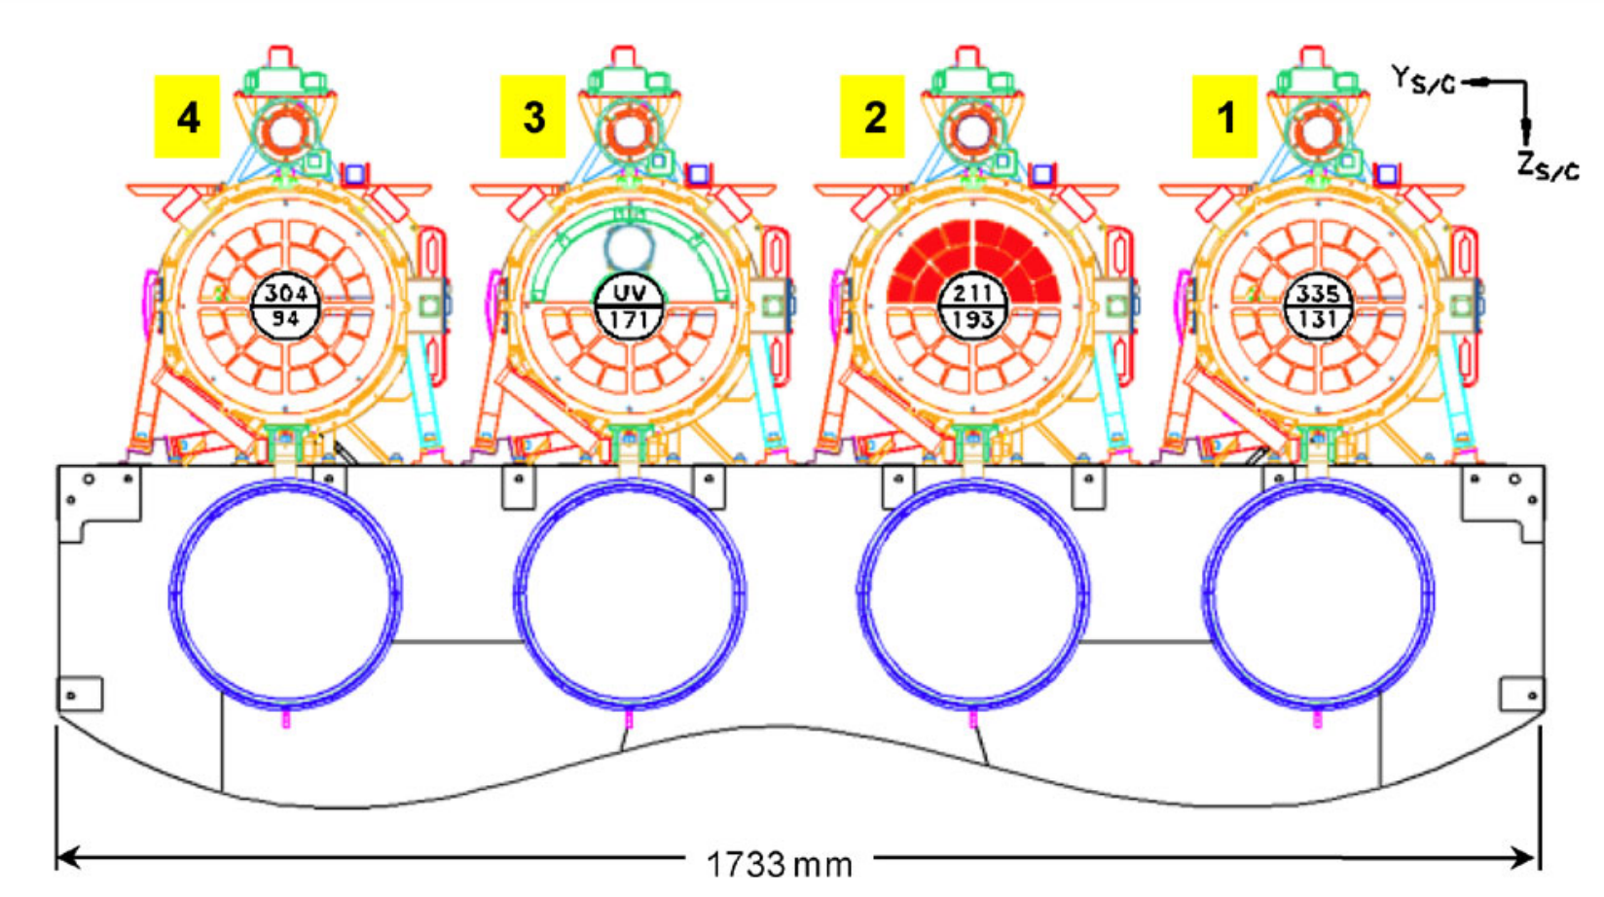
AIA telescope layout. Telescope 2 has aperture blade to select between it’s two wavelength channels. Rest of the channels rely on the filters in filter wheels to select the desired channels.
(Image credit: Lemen et al., 2011)

Slide 34
